Slide 1

Student Performance Data Analysis

Slide 2

INTRODUCTION
Performance analysis of outcome based on learning is a system which will strive for excellence at different levels and diverse dimensions in the field of student’s interest.
This paper proposes a complete system that is developed to analyze and predict the student's performance only.
The proposed analyzes the students demographic data, study related and psychological characteristics to extract all possible knowledge from students and teachers.

Slide 3
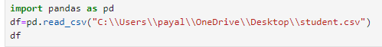
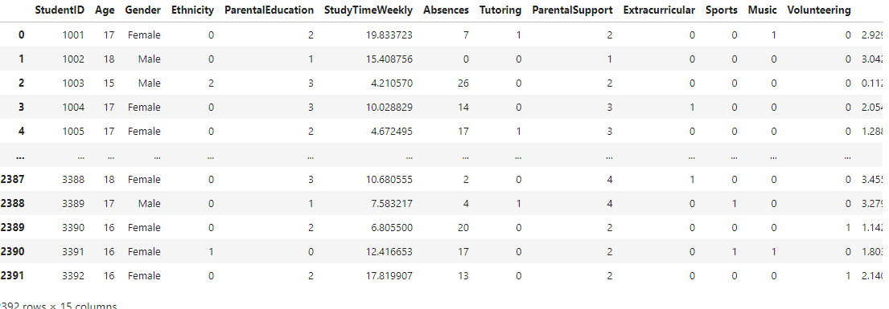
Read csv file
INPUT
OUTPUT

Slide 4
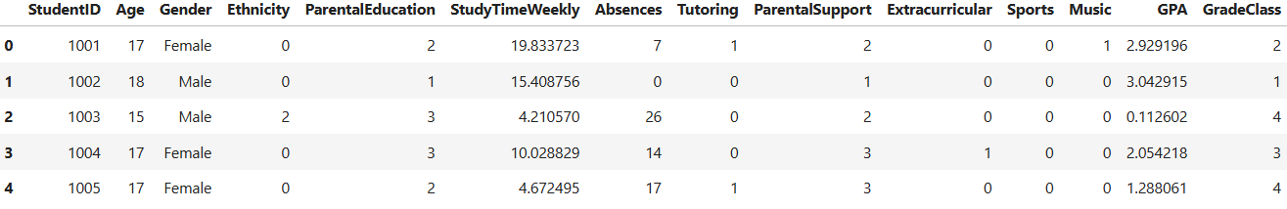
IMPLEMENTATION OF DROP FUNCTION
DROP FUNCTION removes the definition of an existing function. To execute this command the user must be the owner of the function. The argument types to the function must be specified, since several different functions can exist with the same name and different argument lists.
INPUT
OUTPUT

Slide 5
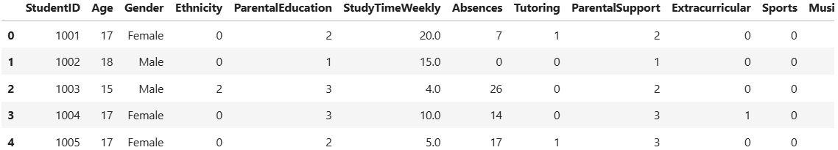
The `round()` function in Python is used to round numbers. It takes two parameters: the number to be rounded and, optionally, the number of decimal places. If no decimal places are specified, it rounds to the nearest integer.
ROUND OFF:-
INPUT
OUTPUT

Slide 6
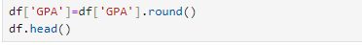
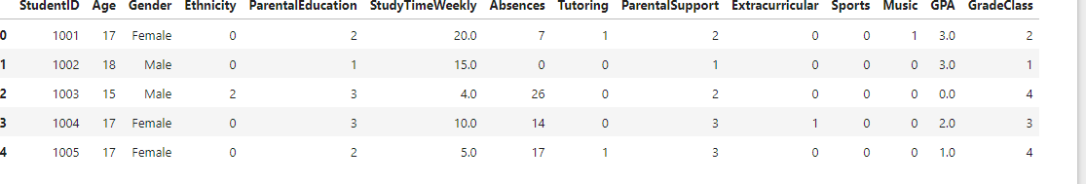
Round off :-
The `round()` function in Python is used to round numbers. It takes two parameters: the number to be rounded and, optionally, the number of decimal places. If no decimal places are specified, it rounds to the nearest integer.
INPUT
OUTPUT

Slide 7
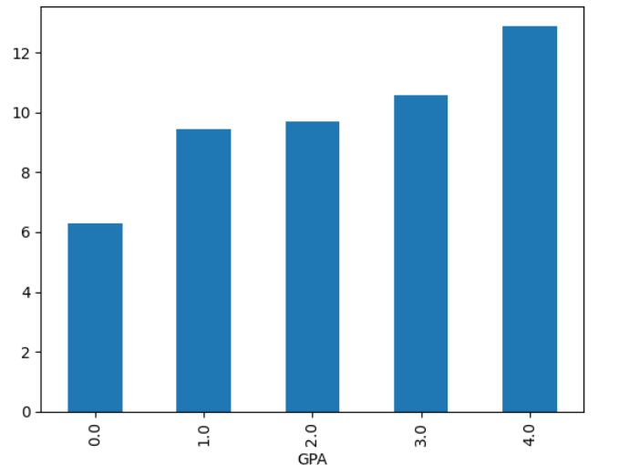
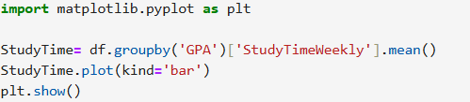
PLOTTING A BAR GRAPH USING GROUPBY FUNCTION
Groupby is used for grouping the data according to the categories and applying a function to the categories. It also helps to aggregate data efficiently. The Pandas groupby() is a very powerful function with a lot of variations. It makes the task of splitting the Dataframe over some criteria really easy and efficient.
INPUT
OUTPUT

Slide 8
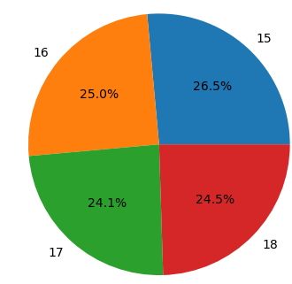
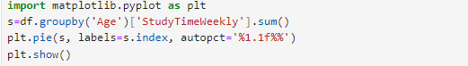
Pie Chart Implementation
matplotlib.pyplot.plot() function is a fundamental component of the Matplotlib library, specifically within the Pyplot module. It serves the purpose of generating a 2D hexagonal binning plot based on the given data points represented by the variables x and y. It connects data points with lines, allowing customization of the plot’s appearance through parameters such as line styles and markers. This versatile function is widely used for data visualization in various domains.
INPUT
OUTPUT

Slide 9

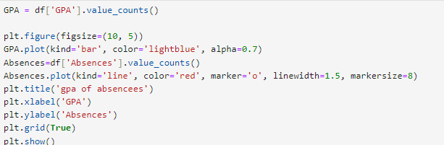
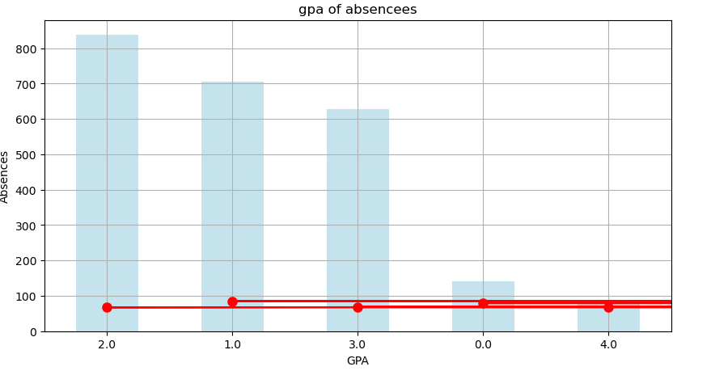
Plotting A Bar Graph
INPUT
OUTPUT

Slide 10
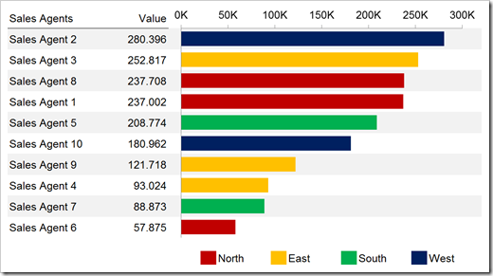
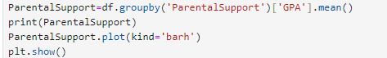
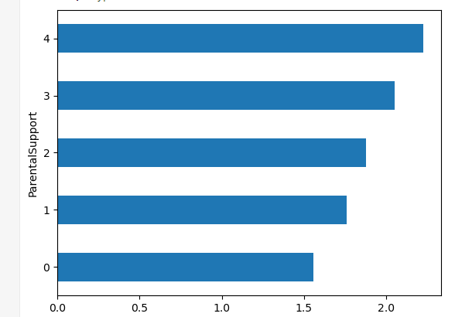
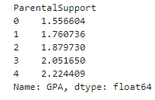
Horizontal Bar Graph
INPUT
OUTPUT

Slide 11
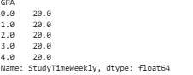
IMPLEMENTATION OF max FUNCTION
The max() function returns the item with the highest value, or the item with the highest value in an iterable . If the values are strings, an alphabetically comparison is done.
INPUT
OUTPUT

Slide 12
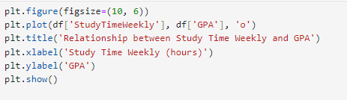
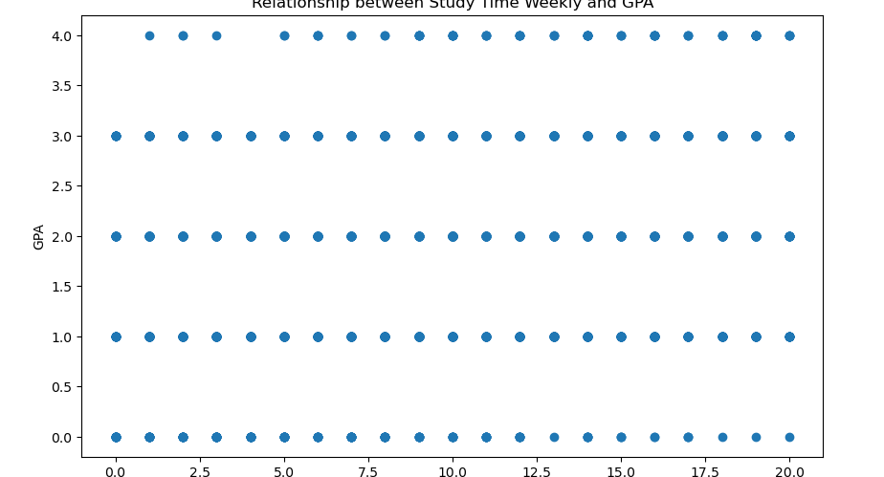
Relation between Study Time Weekly and GPA
INPUT
OUTPUT

Slide 13
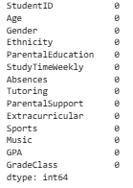
IMPLEMENTATION OF SUM FUNCTION
The sum of numbers in the list is required everywhere. Python provides an inbuilt function sum() which sums up the numbers in the list.
INPUT
OUTPUT

Slide 14
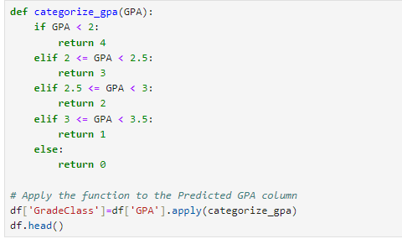
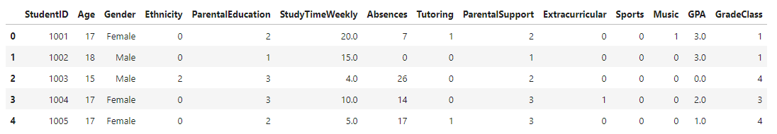
Adding Grade Class to the GPA and Final Dataframe with correct and Predicted
INPUT
OUTPUT

Slide 15
Fetching total number of rows
the shape() method is used to fetch the dimensions of Pandas and NumPy type objects in python.
INPUT
OUTPUT

Slide 16
IMPLEMENTATION OF SUM FUNCTION
The sum of numbers in the list is required everywhere. Python provides an inbuilt function sum() which sums up the numbers in the list.
INPUT
OUTPUT

Slide 17
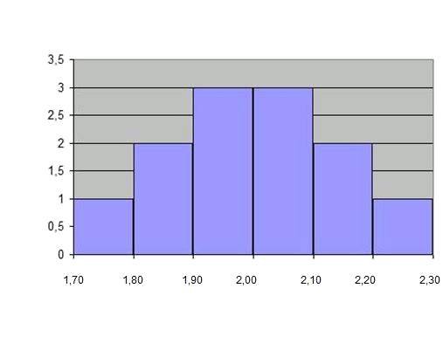
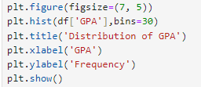
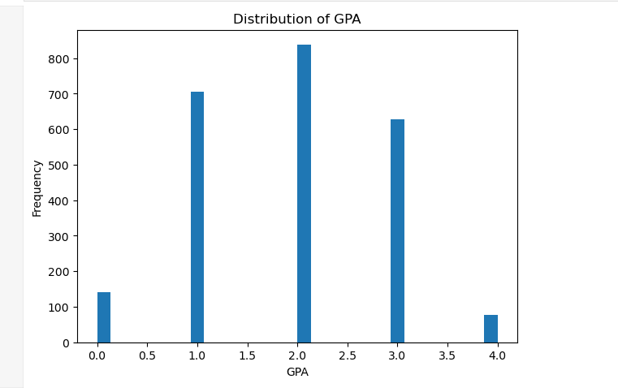
Histogram
INPUT
OUTPUT

Slide 18


